Slide 1
COMPUTER SCIENCE PROJECTS 31/03/22
BY Onyekonwu Chizuroke

Slide 2
Pseudocode for project 1
INPUT starting position which is (0,0) facing east
SET Aminat at starting position
MOVE 3 steps towards the direction she is facing
PICK the flower
SET Aminat to face South
MOVE 2 steps towards the direction she is facing
PLANT flower at current location
SET Aminat to face East once again
MOVE 1 step towards the direction she is facing

Slide 3
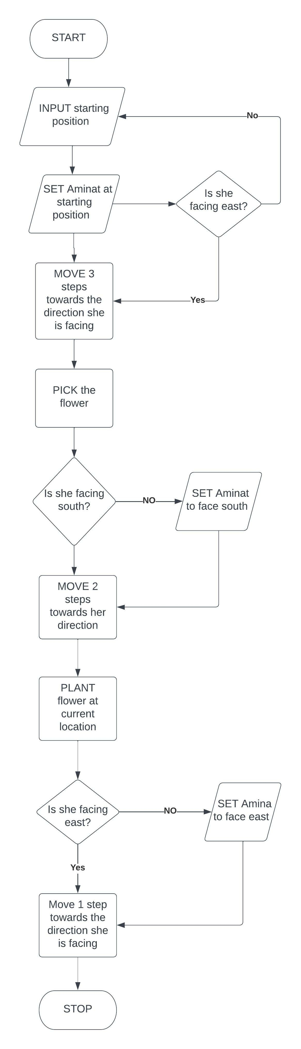
FLOWCHART FOR PROJECT 1

Slide 4
PSEUDOCODE FOR PROJECT II
INPUT emp = names of employees
INPUT user = name of user
IF user in emp,
PRINT welcome back to Jane’s express delivery
ELSE
PRINT please take your leave.

Slide 5
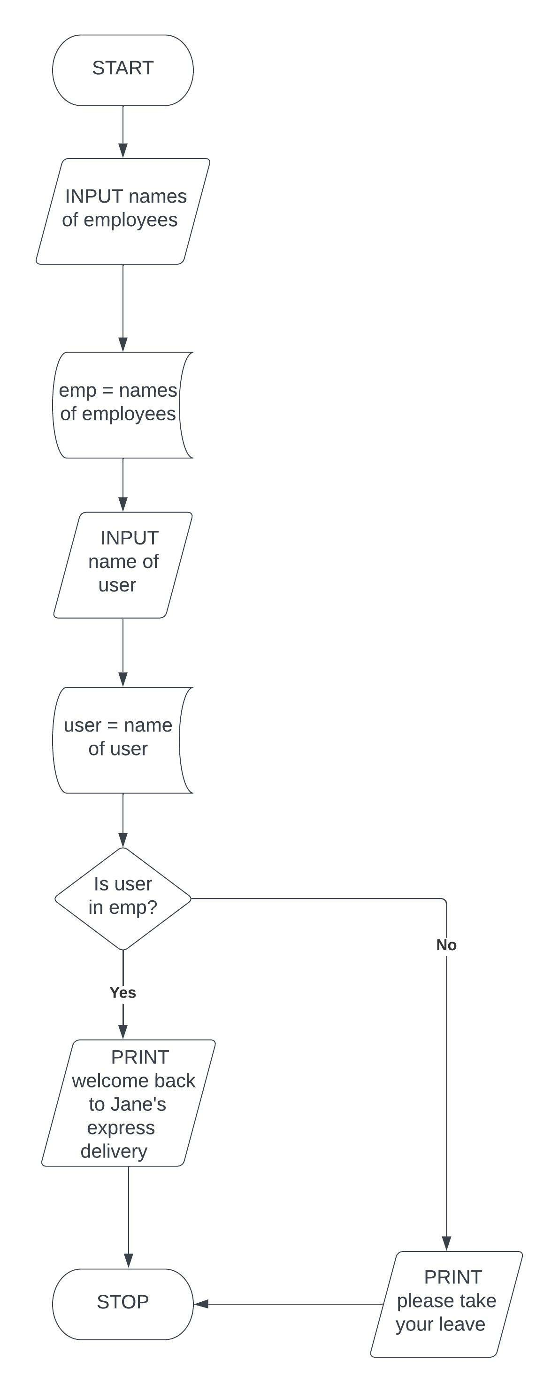
FLOWCHART FOR PROJECT II

Slide 6
PSEUDOCODE FOR PROJECT III
INPUT weight = weight of package
INPUT address = delivery address
IF weight is > or = 10kg and address is PAU,
PRINT delivery charge is #2000
ELIF weight < 10kg and address is PAU,
PRINT delivery charge is #1500
ELIF weight > or = 10kg and address is Epe,
PRINT delivery charge is #5000
ELSE
PRINT delivery charge is #4000

Slide 7
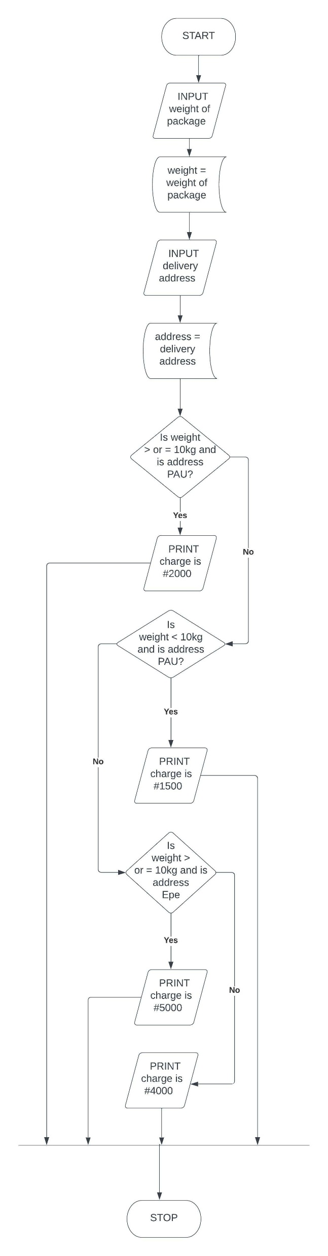
FLOWCHART FOR PROJECT III

Slide 8
PSEUDOCODE FOR PROJECT IV
INPUT name of individual
INPUT JS = score in jamb
INPUT subjects = Mathematics, Physics, Computer Science, Data processing, English language
INPUT grades = A, B, C
INPUT int = interview result
IF js > or = 230, and subjects = grades and int = pass,
PRINT congrats, you have been offered admission
ELSE
PRINT your admission has been declined

Slide 9
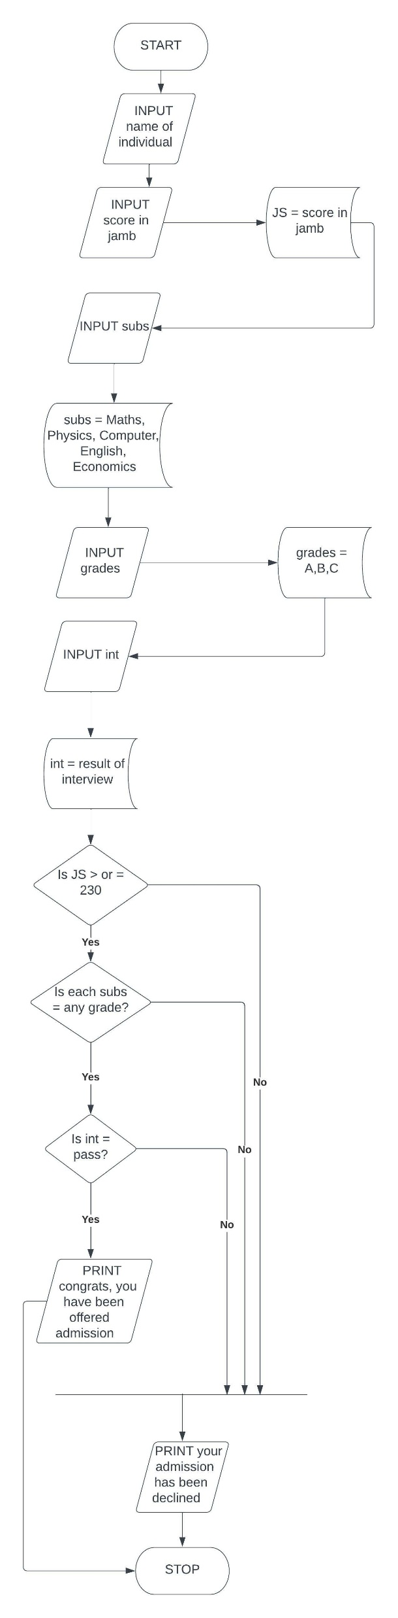
FLOWCHART FOR PROJECT IV

Slide 10
PSEUDOCODE FOR PROJECT V
INPUT starting position i.e. (0,0) facing east
SET the boy at start pos.
SET the boy to face south
MOVE 2 steps towards the direction he is facing
GIVE flower to the girl at that position
SET the girl to face east
MOVE 3 steps towards the direction she is facing
PLANT flower inside vase at that position
MOVE 2 steps south while facing her current direction

Slide 11
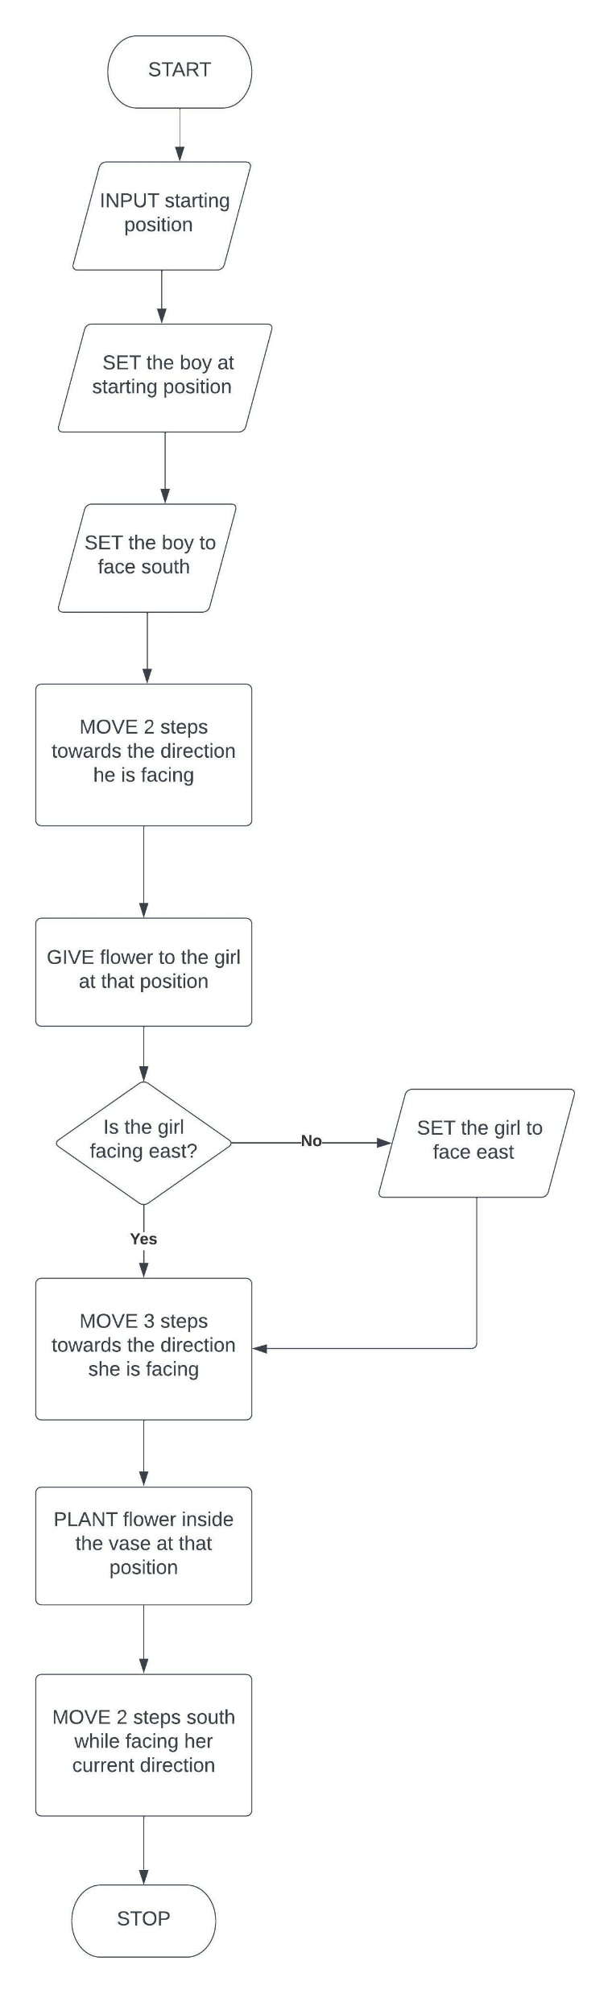
FLOWCHART FOR PROJECT V

